Slide 1
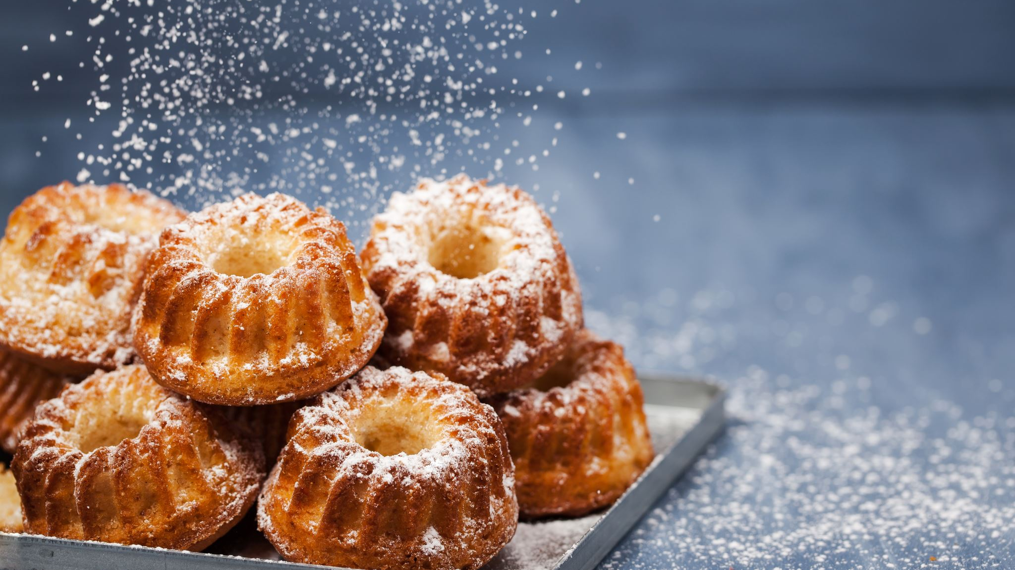
My favourite food.

Slide 2
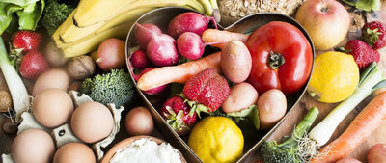
Healthy food in my life!!!!

Slide 3
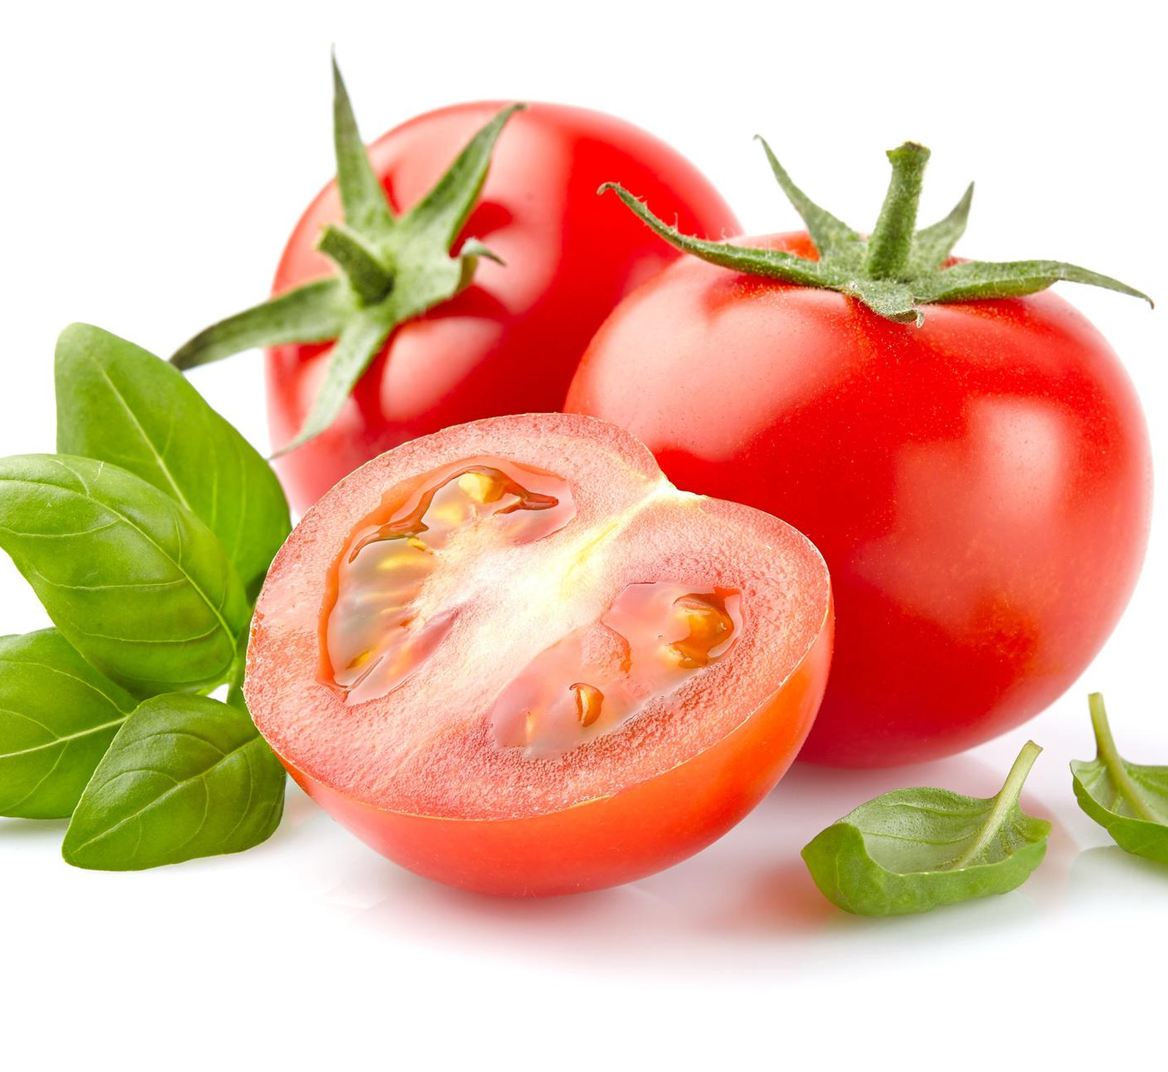
Pomidor
Tomato

Slide 4
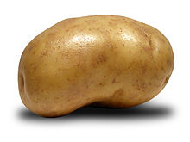
Ziemniak
Potato

Slide 5
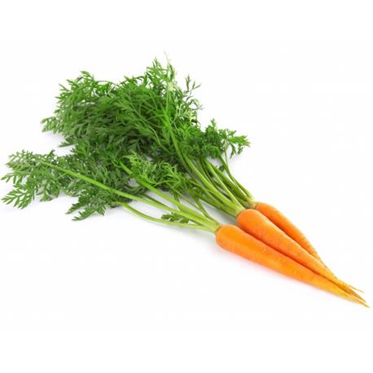
Marchewka
Carrot

Slide 6
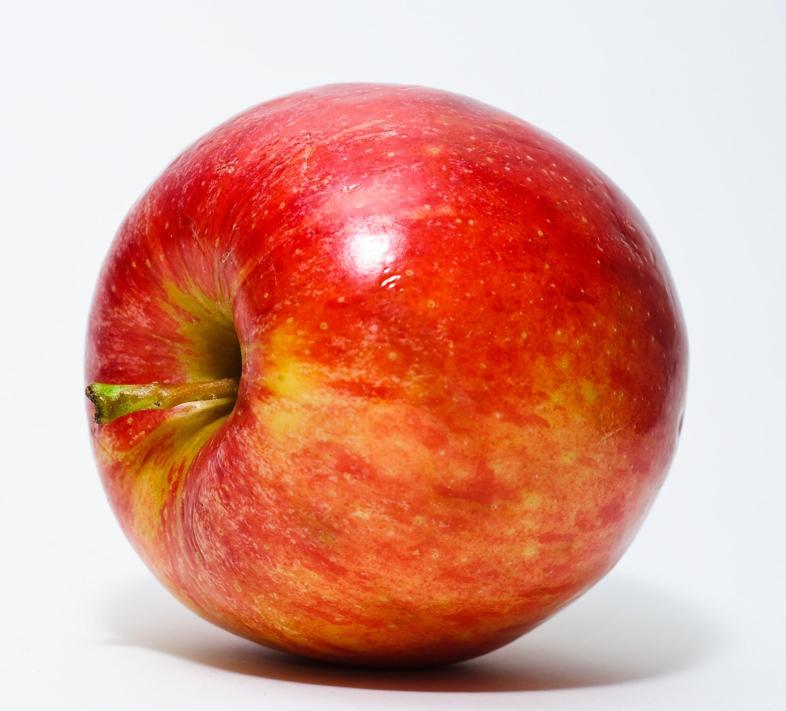
Jabłko
Apple

Slide 7

Cytryna
Lemon

Slide 8

Woda
Water

Slide 9
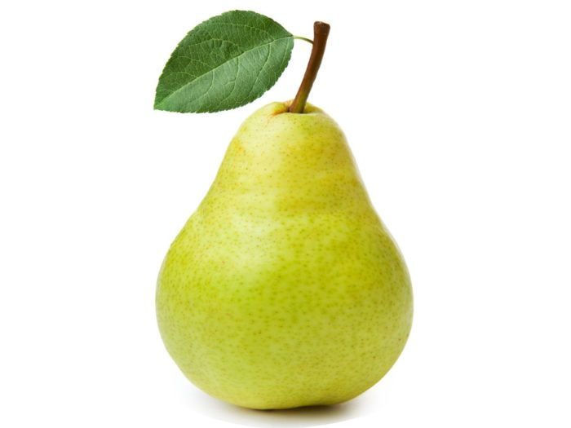
Gruszka
pear

Slide 10
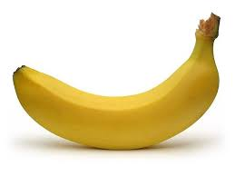
Banan
banana

Slide 11
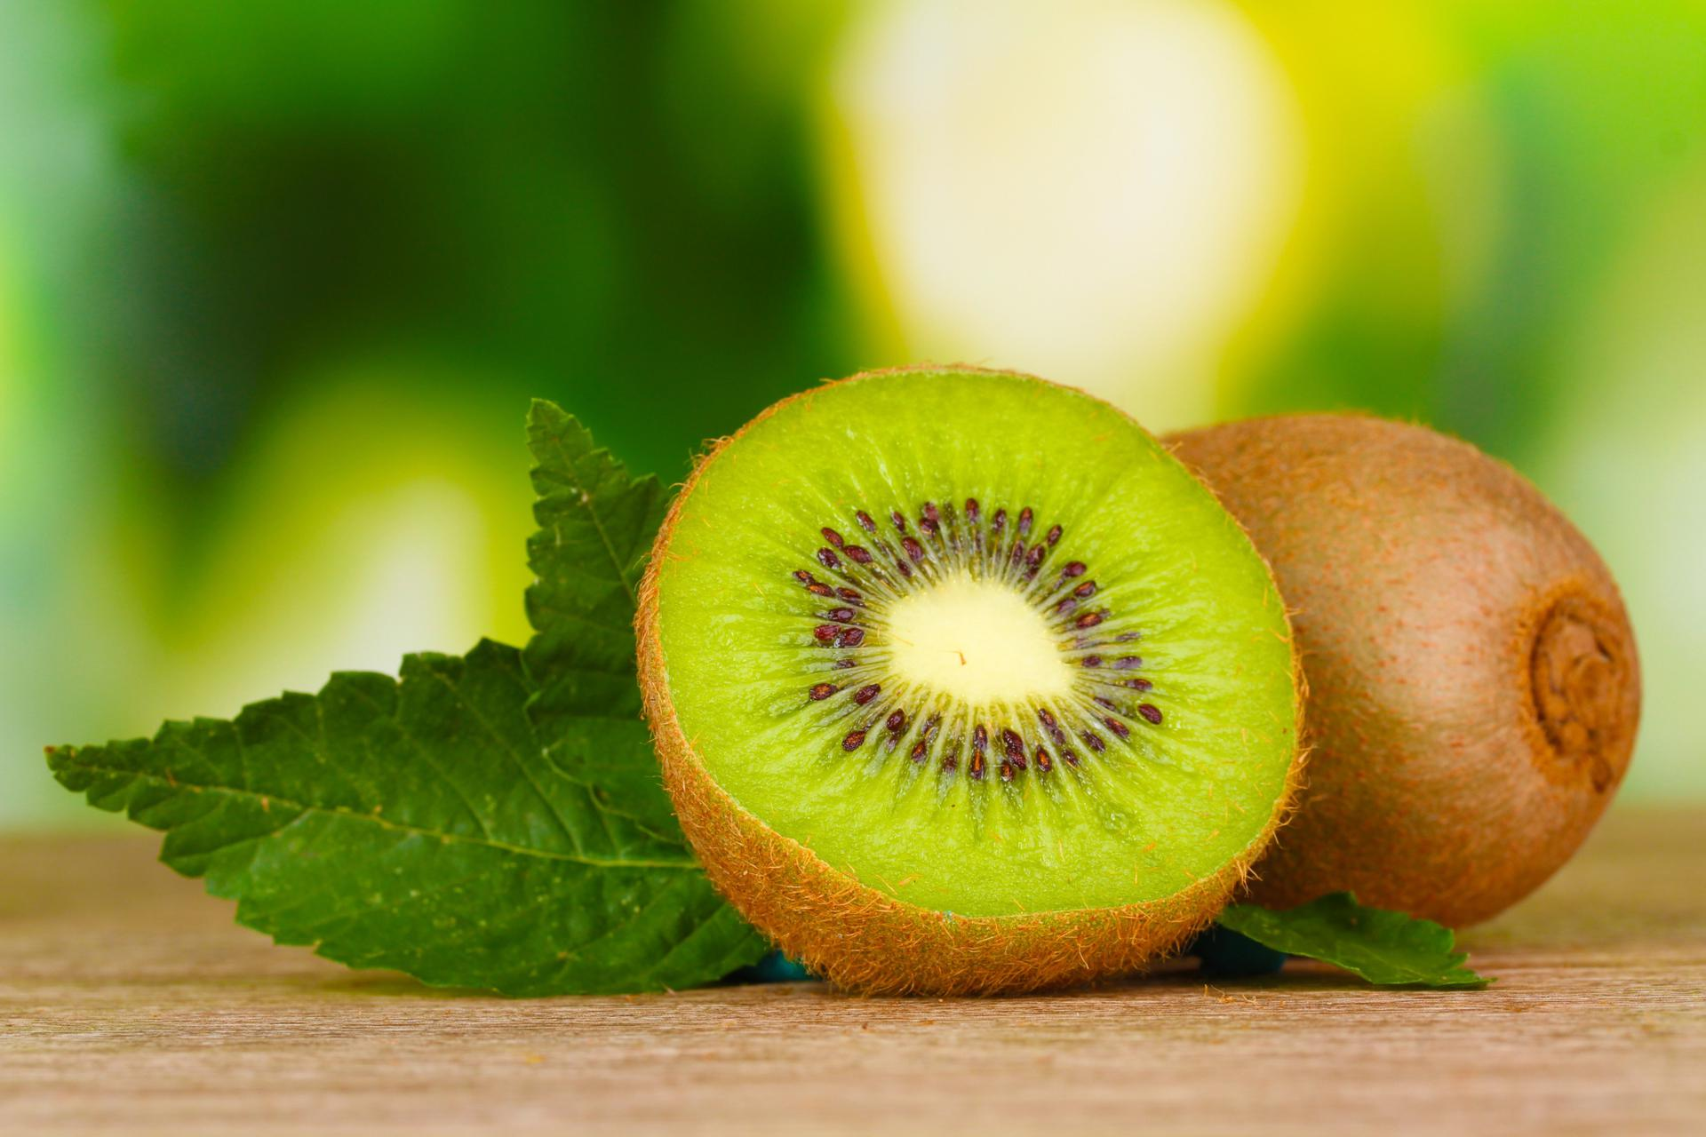
Kiwi
kiwi

Slide 12
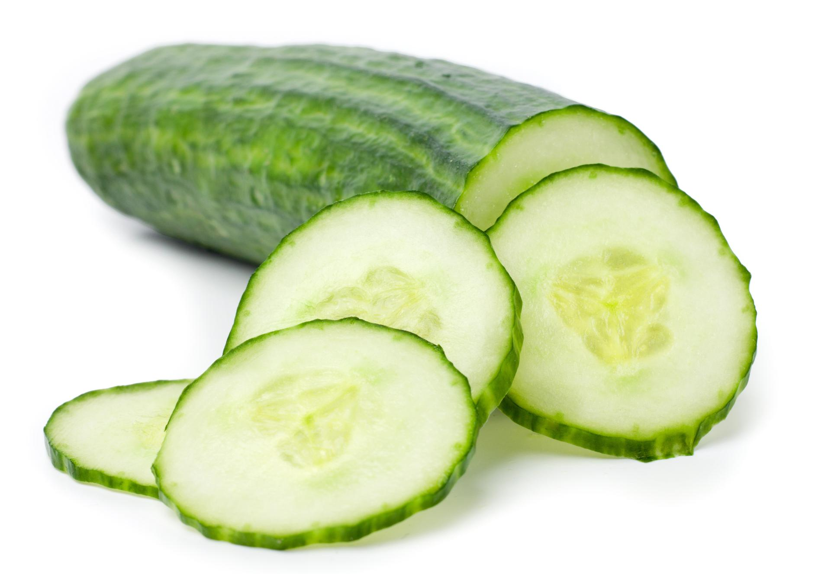
Ogórek
Cucumber

Slide 13
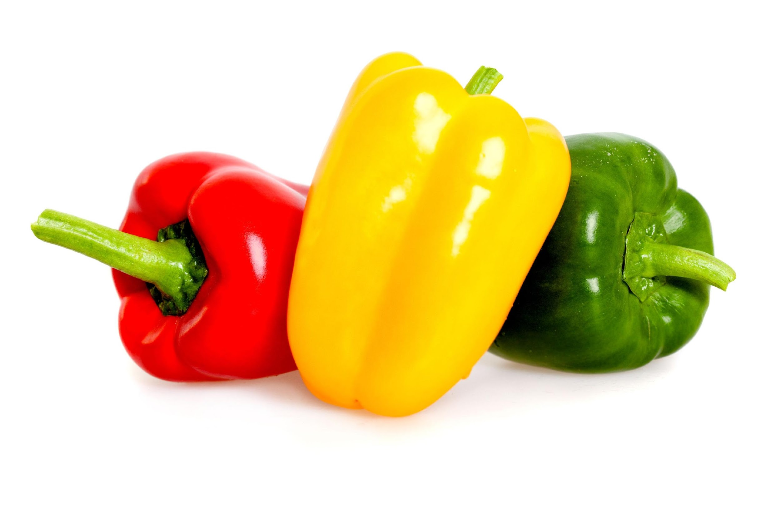
Papryka
pepper

Slide 14
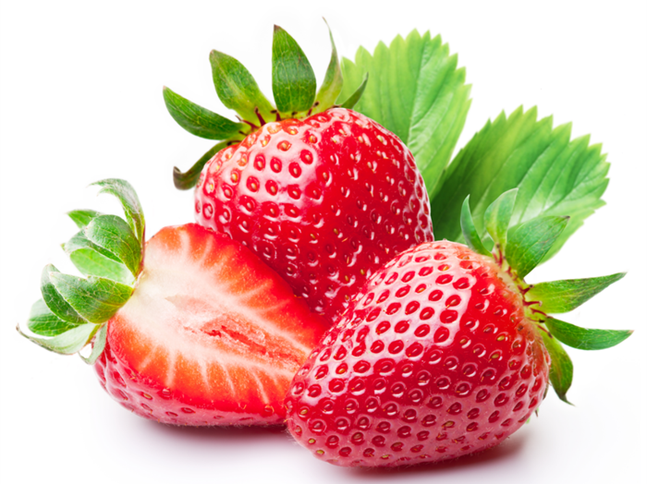
Truskawki
Strawberry

Slide 15

Thank you for watching my presentation
Julia

